Slide 1
Improving Student Test Scores
Group 2:
Melisha Allen, Leonard Frost, Nandini Patel, Isaiah Robinson
Notes:
Melisha

Slide 2
Problem Statement
Students’ test scores are impacted by inconsistent access to lunch, and frequent absenteeism is associated with lower student test performance. For instance, we have noticed that students that have access to free/reduced lunch have scored higher on the SC Ready Math > Vertical S scores compared to students who don’t have access to free lunch. However, these students also have a higher absenteeism range from 0-8 days compared to students that have no free lunch with a range of 1-3 days of absence.
Notes:
Melisha

Slide 3
Goal Statement
The goal is to increase the overall SC Ready Math test scores from 550 with a target average of 680 by the end of 2026-2027 school year.
Notes:
Melisha

Slide 4
Inputs
Outputs
Demographics
Student Gender
Student Race
Student Ethnicity – is Hispanic
Student ZIP Code
Educational Status
Student Learning Disability – Autism
Student Special Education
Risk Indicators
Student Free/Reduced Lunch
Student PIP Status
Student Days Absent
Student Discipline
Family Life
Instructional Factors
SC Ready Math > Vertical S
Notes:
Melisha

Slide 5

Baseline Data Analysis
Notes:
Nandini
For our baseline data analytics, we conducted Graphical Summary of SC Ready Math > Vertical S by the Student Free/Reduced Lunch variable and Student Days Absent variable.

Slide 6
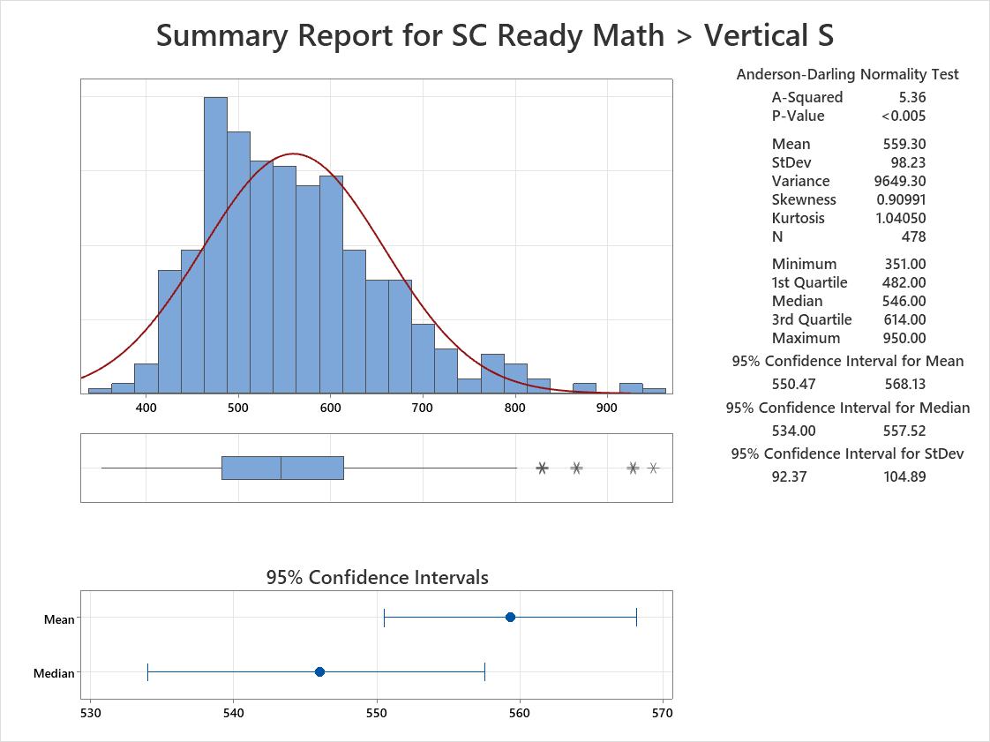
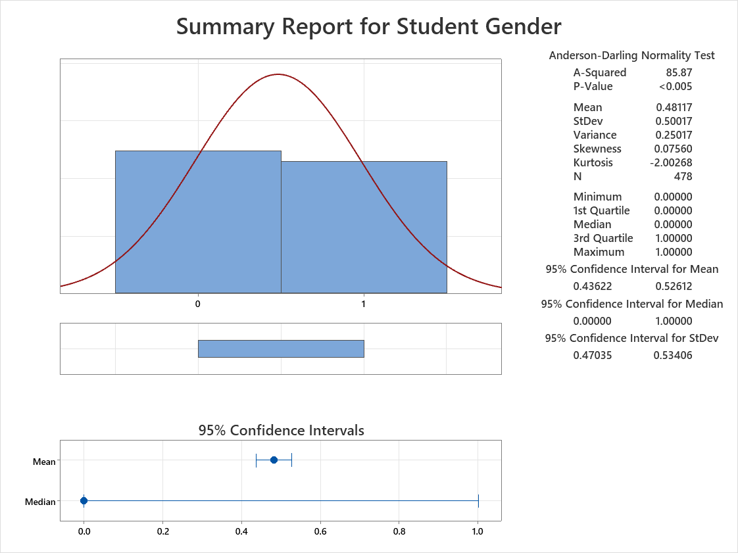
Individual Summary Reports for each Variable
Notes:
I added the individual summary reports to all of the variables, but seeing how only our testing variable is the only one that is continuous, I think that in our papers it should be the only one we should mention. If you want to mention the other variables, note that all variables have a p-value of <0.005, hence we reject the null hypothesis, and the data is significantly different and does not follow normal distribution.
Below is my interpretation of the graph:
SC Ready Math > Vertical S has a mean of 559.3 with Q1 at 482 and Q3 at 614. Hence, why for our goal statement we chose 550 as the starting point and 680 as our goal. The p-value is less that 0.005, hence we reject the null hypothesis and state that the mean is significantly different. We also have several outliers telling us that the distribution is not normal.

Slide 7
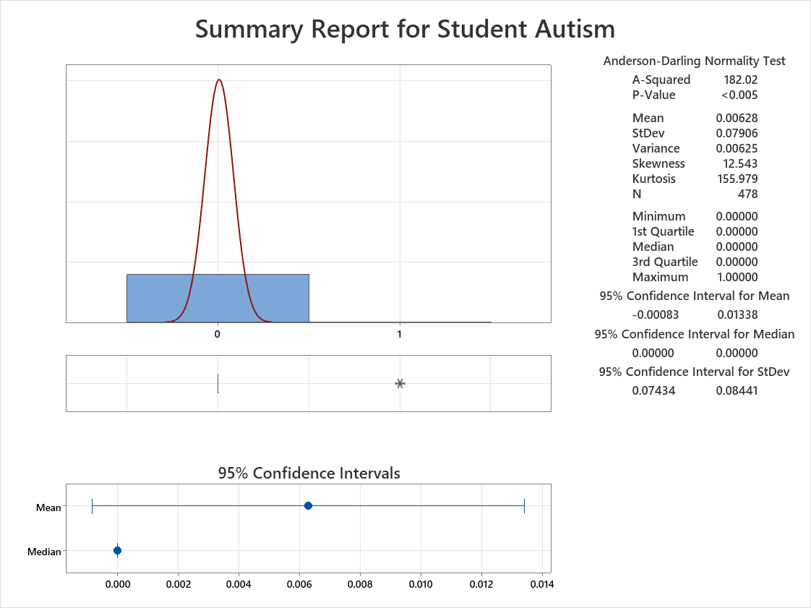
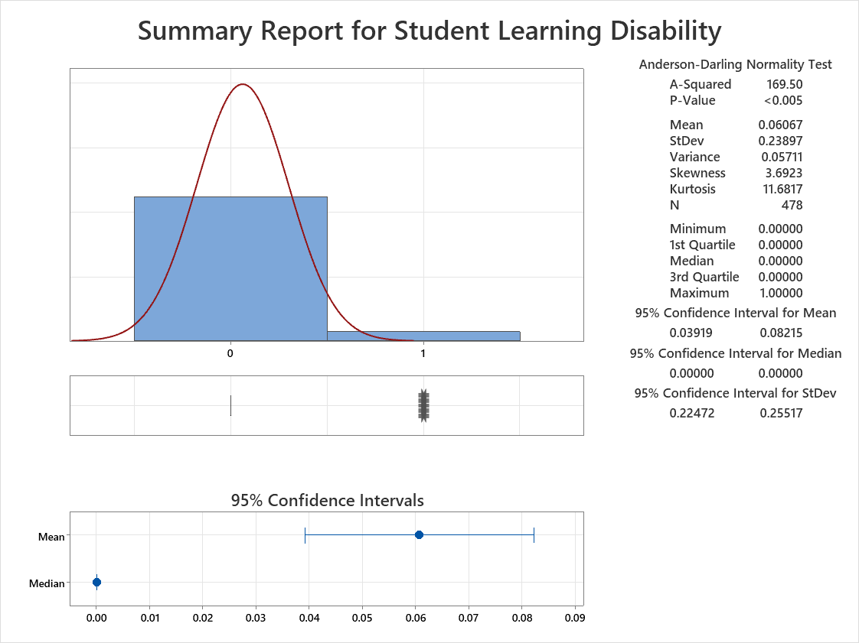

Slide 8
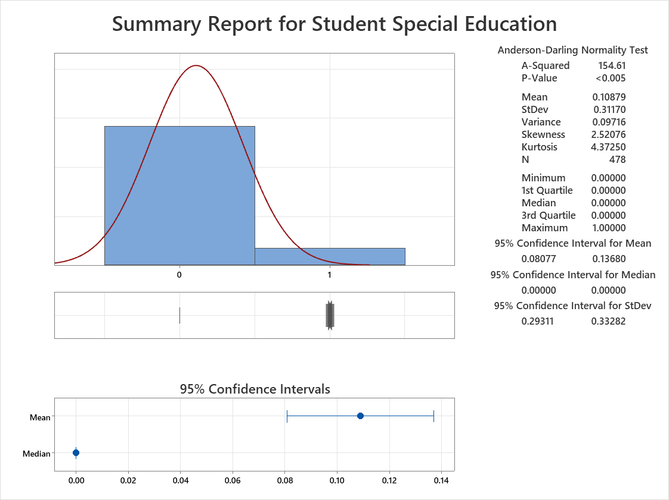
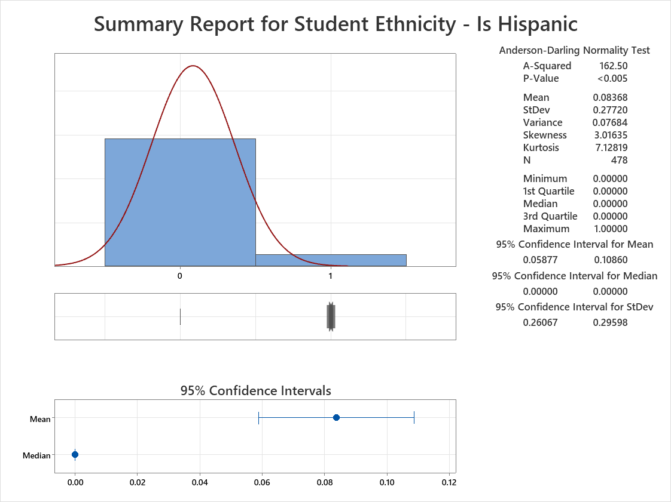

Slide 9
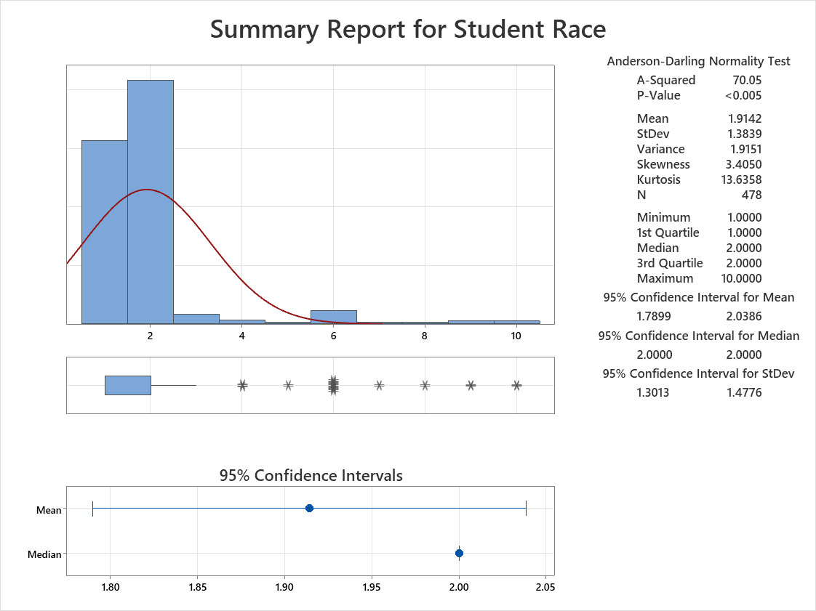
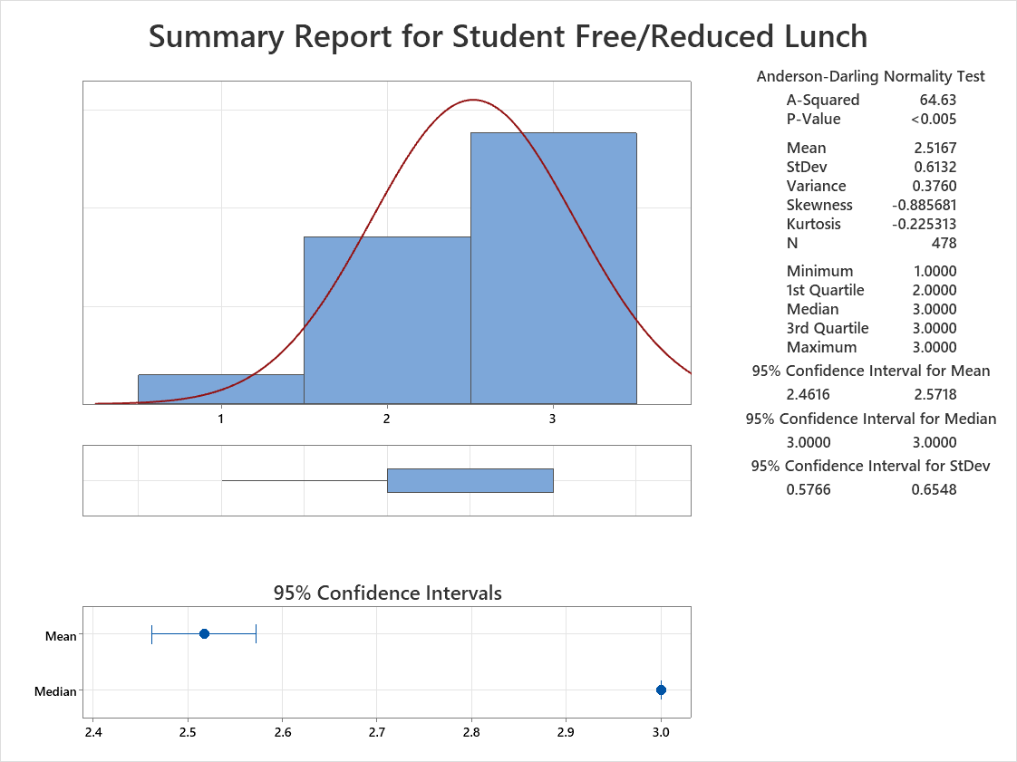

Slide 10
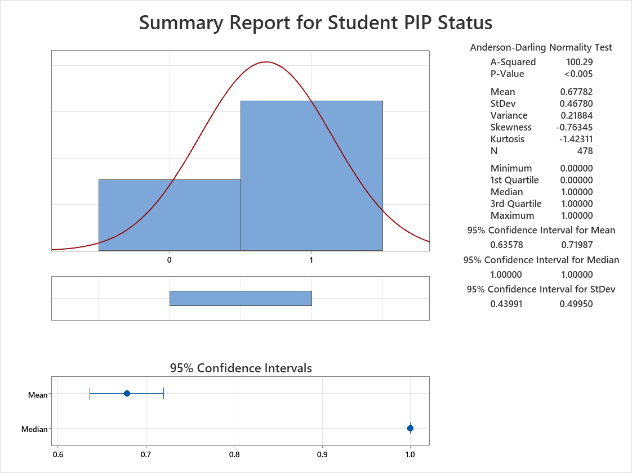
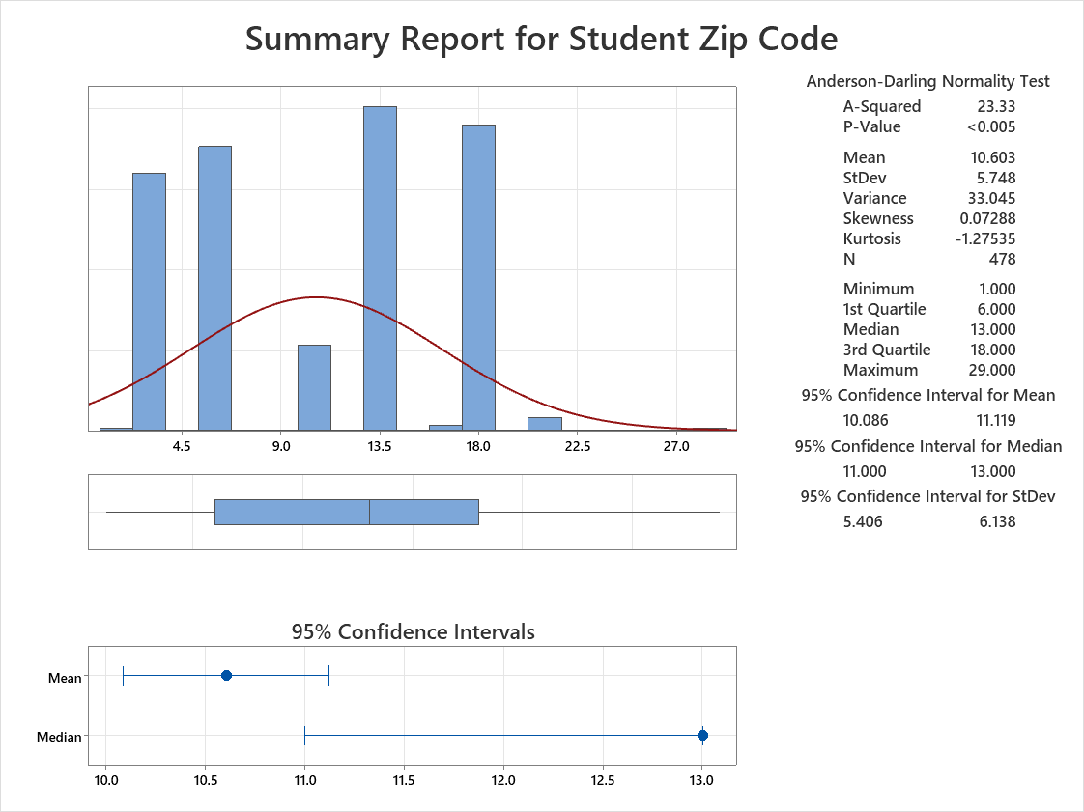

Slide 11
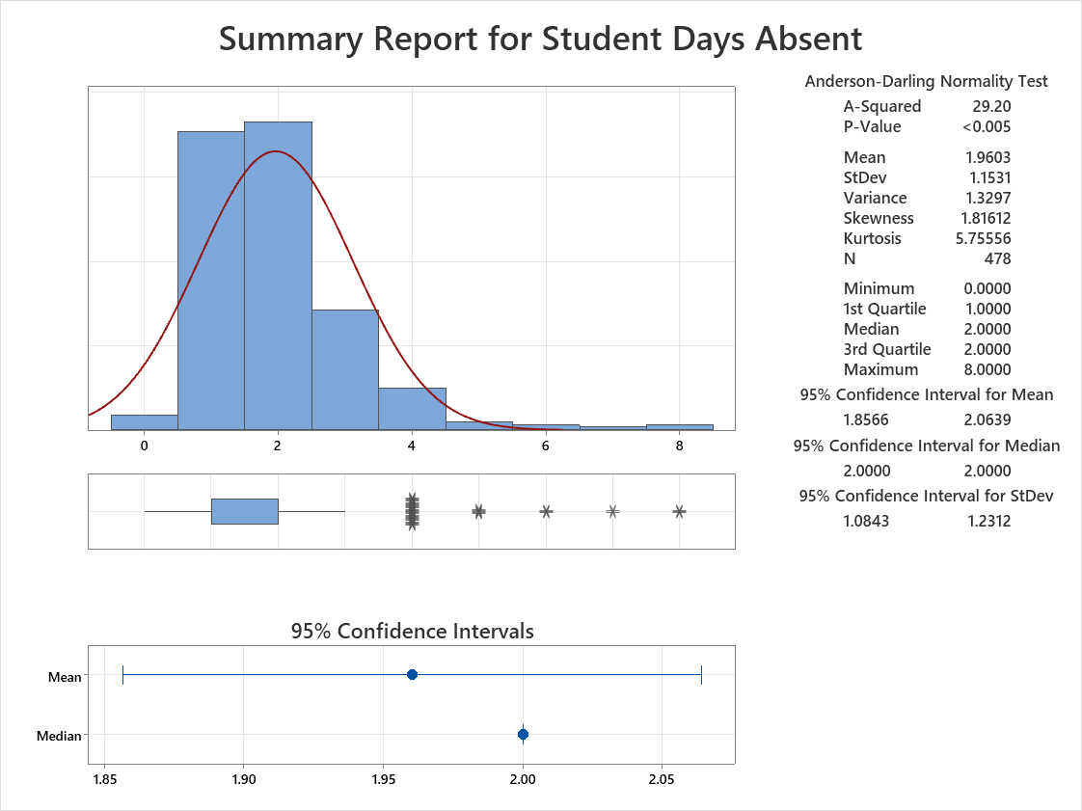
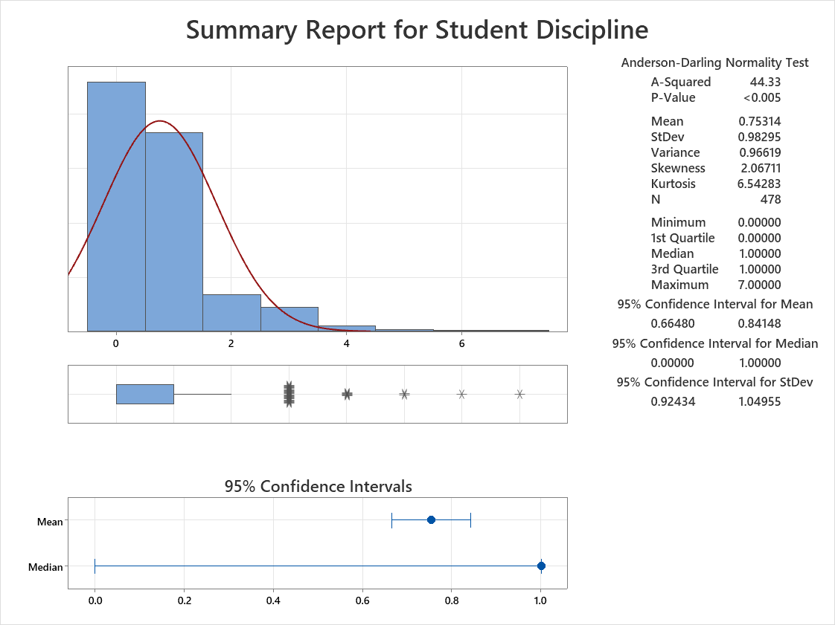

Slide 12
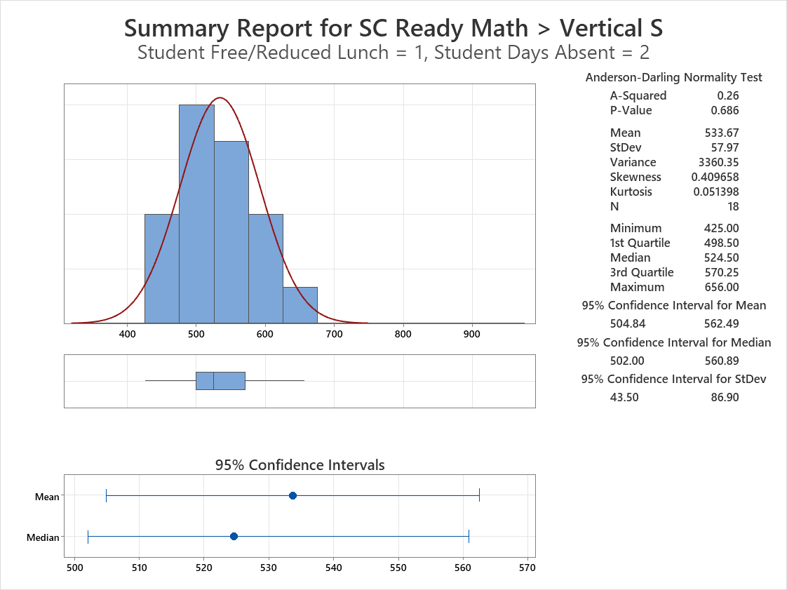
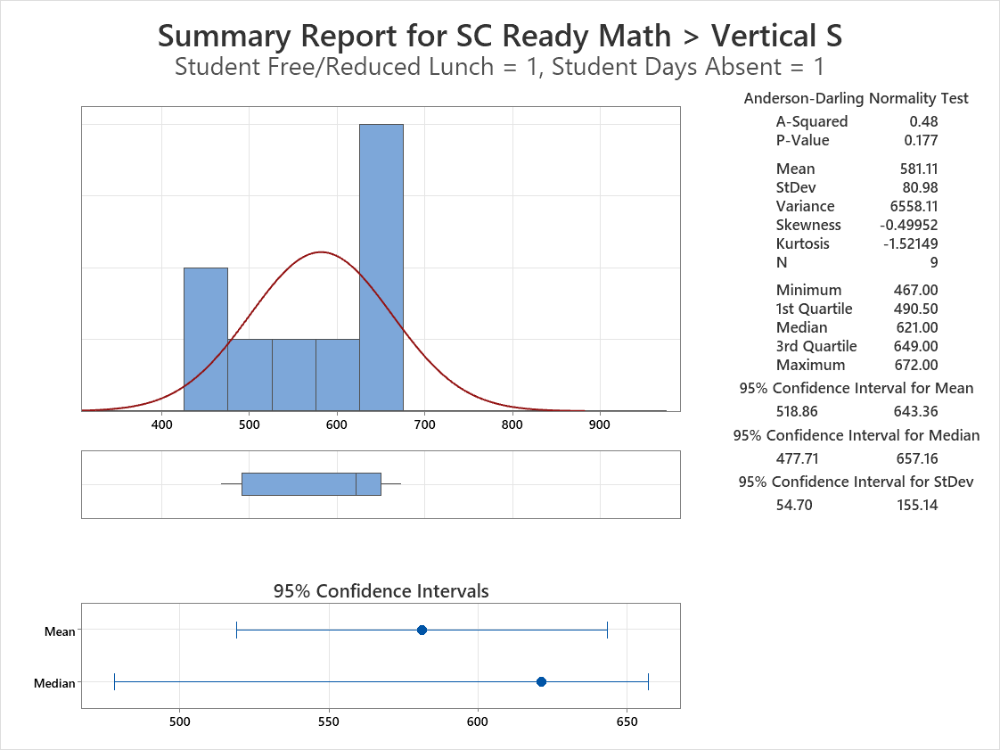
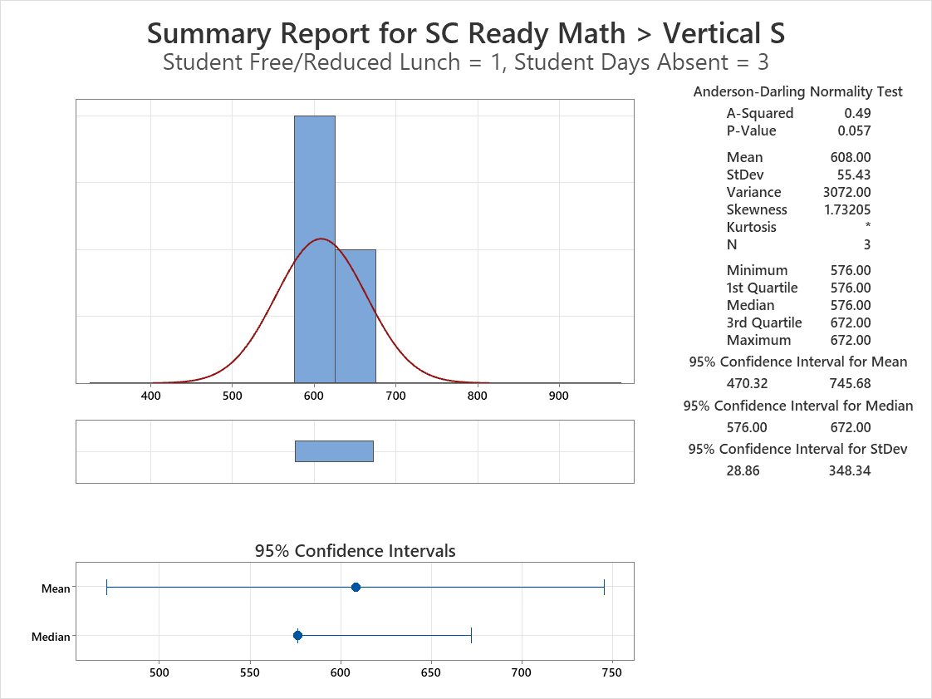
Summary Report for SC Ready Math > Vertical S Free/Reduced = 1
Notes:
Nandini
For our null hypothesis, we are stating if the means for the selected input variables are equal to each other.
Here we can see summary reports for the testing variable when Free/Reduced Lunch is equal to 1. We can see that these 3 reports have no outliers.
However, since the p-values are greater that 0.05, we fail to reject the null hypothesis and state that the means are not significantly different to each other.

Slide 13
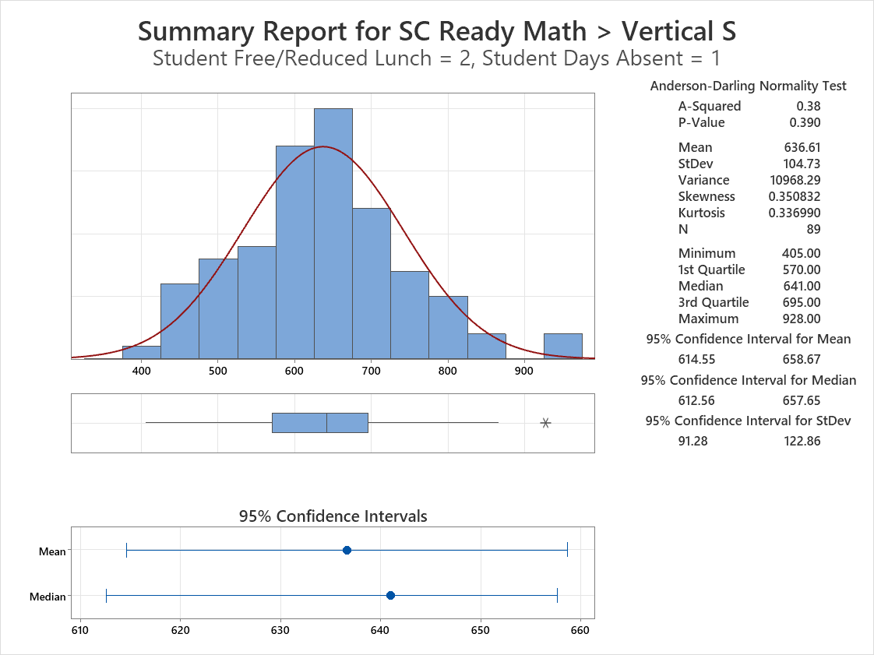
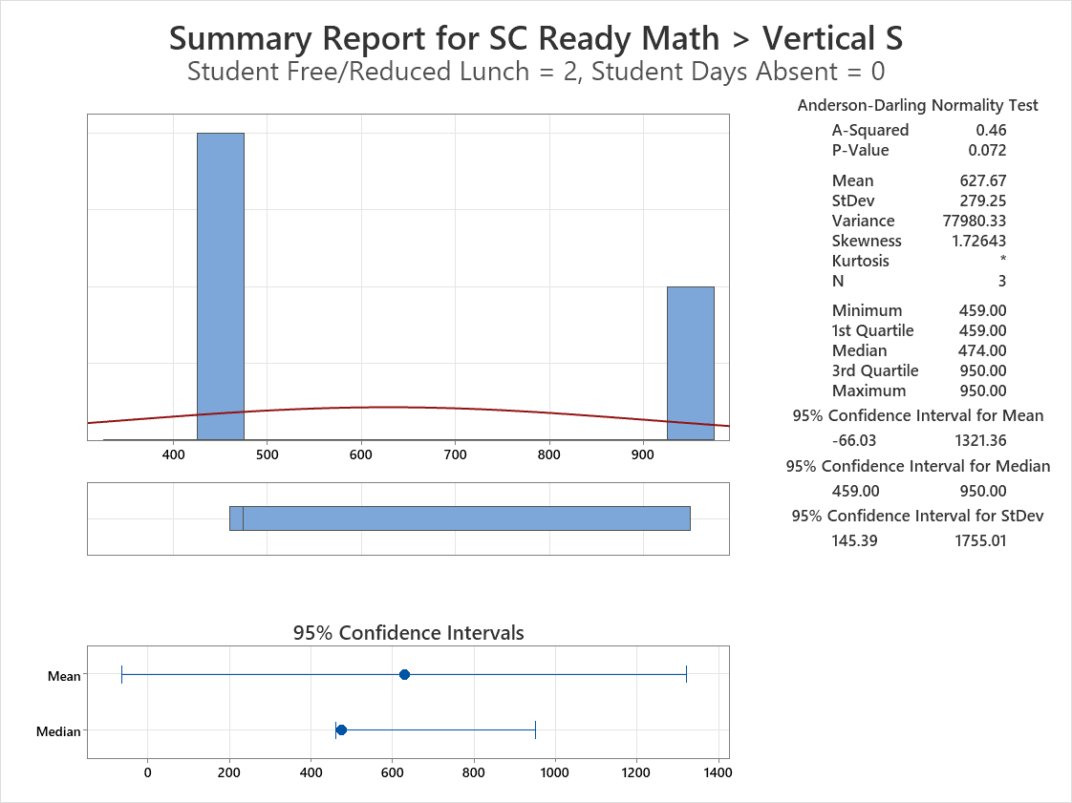
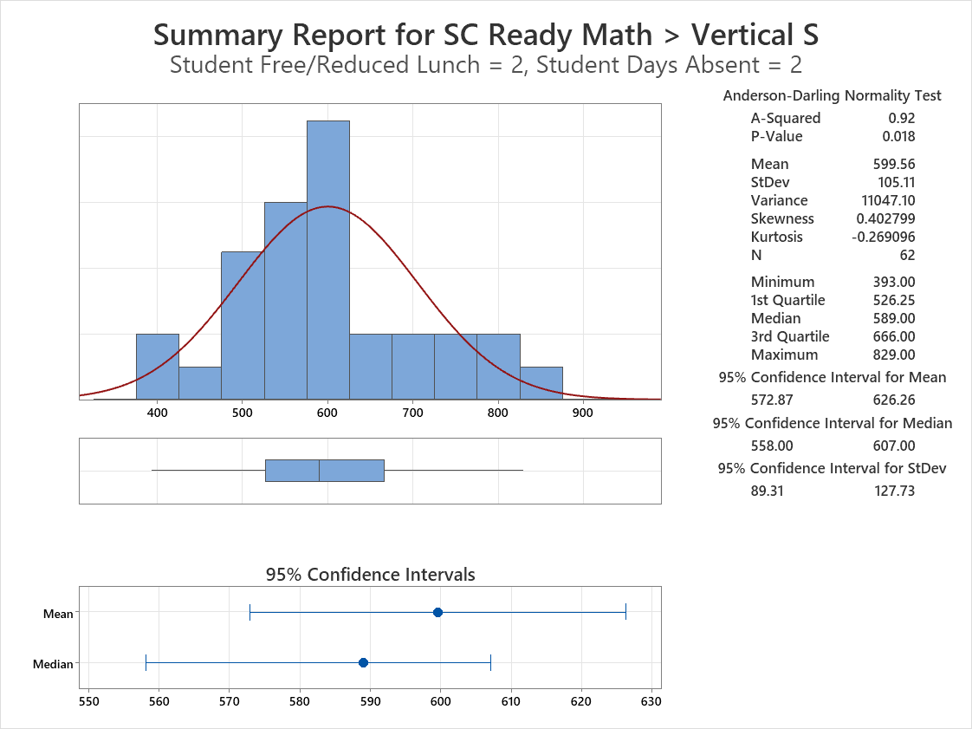
Summary Report for SC Ready Math > Vertical S Free/Reduced = 2
Notes:
Nandini
When Free/Reduced Lunch is equal to 2, we can see that there is only 1 histogram that shows an outlier when Student Days Absent is equals to 1.
However, only when Student Days Absent is equal is 2 is when the p-value is less than 0.05. Hence, we continue to fail reject the null hypothesis.

Slide 14
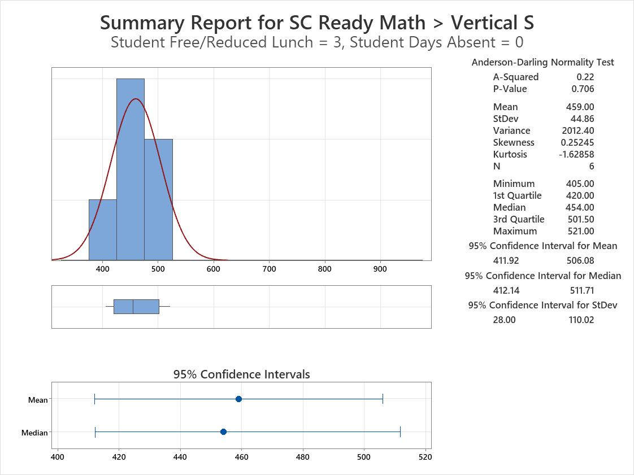
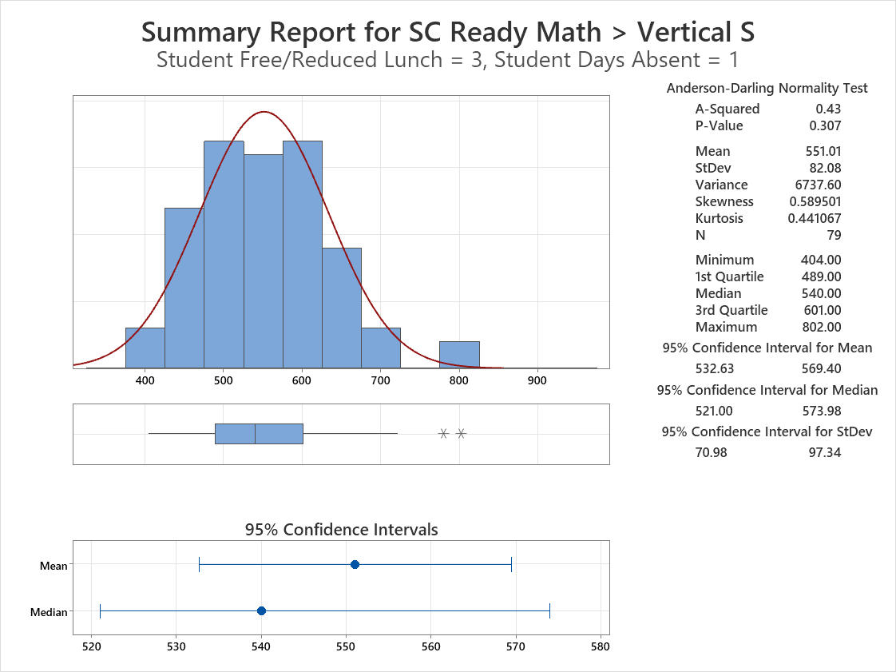
Summary Report for SC Ready Math > Vertical S Free/Reduced = 3 Absent = 0,1
Notes:
Nandini
When Free/Reduced Lunch is 3, we find outliers when the Days Absent is 1, 2 and 4. And p-values are less than 0.05 when Days Absent are 2,3 and 4.

Slide 15
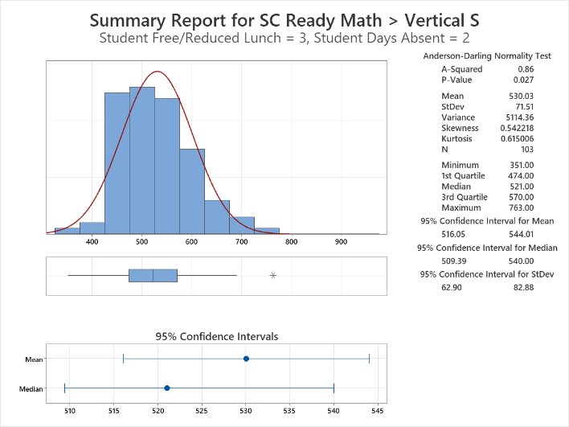
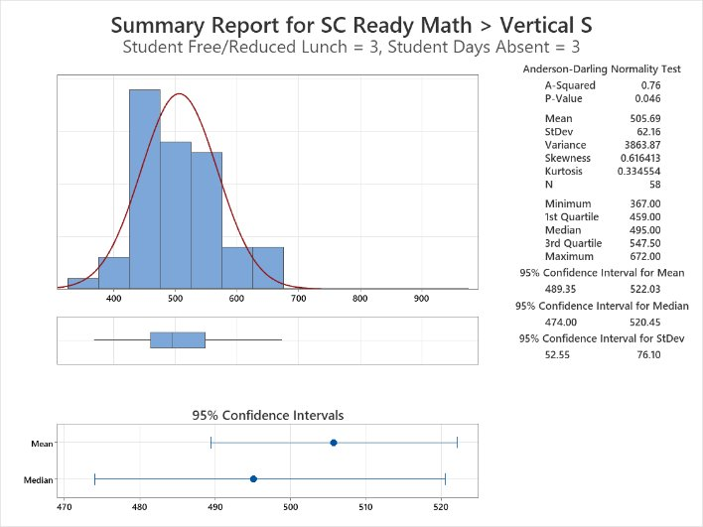
Summary Report for SC Ready Math > Vertical S Free/Reduced = 3 Absent = 2,3
Notes:
Nandini

Slide 16
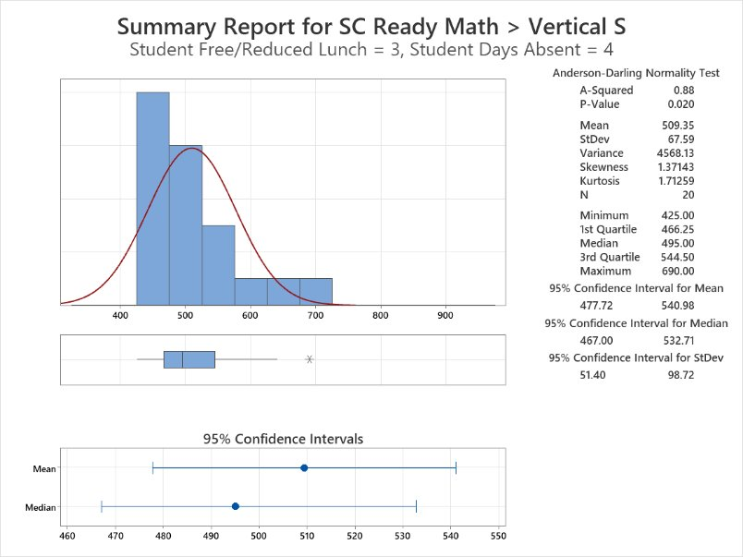
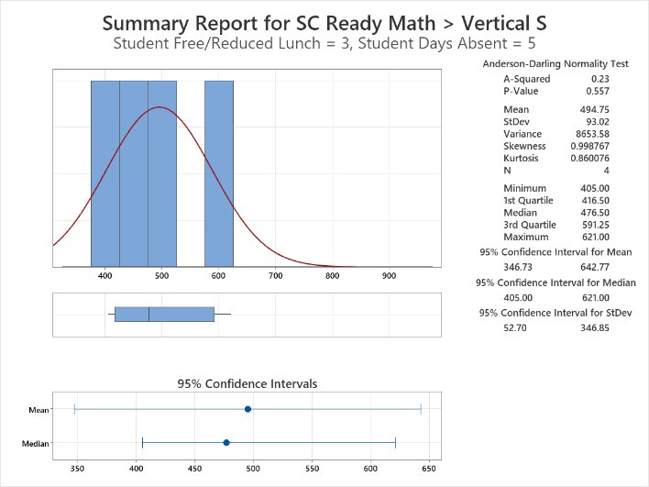
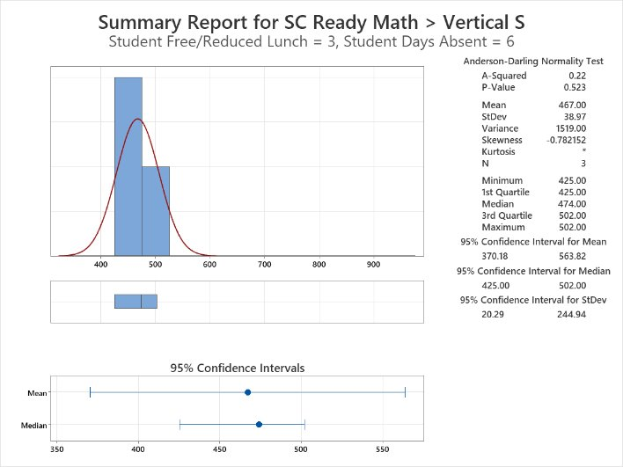
Summary Report for SC Ready Math > Vertical S Free/Reduced = 3 Absent = 4,5,6
Notes:
Nandini
4 out of 13 of these reports shows an outlier and 4 of 13 show p-value are less than 0.05. overall since the majority of the p-values are greater than 0.05, we fail to reject the null hypothesis and state the means are not equal to each other.

Slide 17
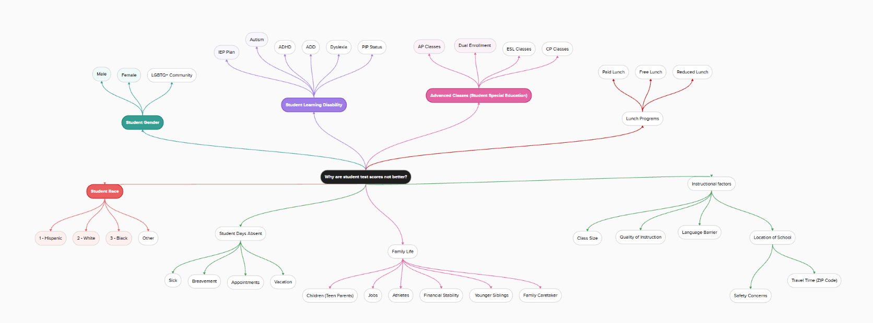
Root Cause Brainstorming
Notes:
Isaiah

Slide 18
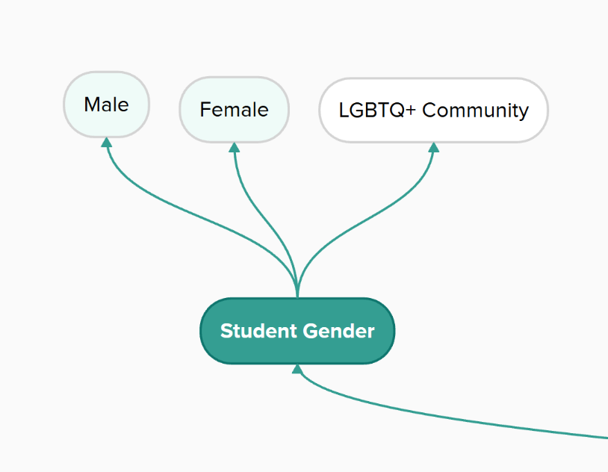
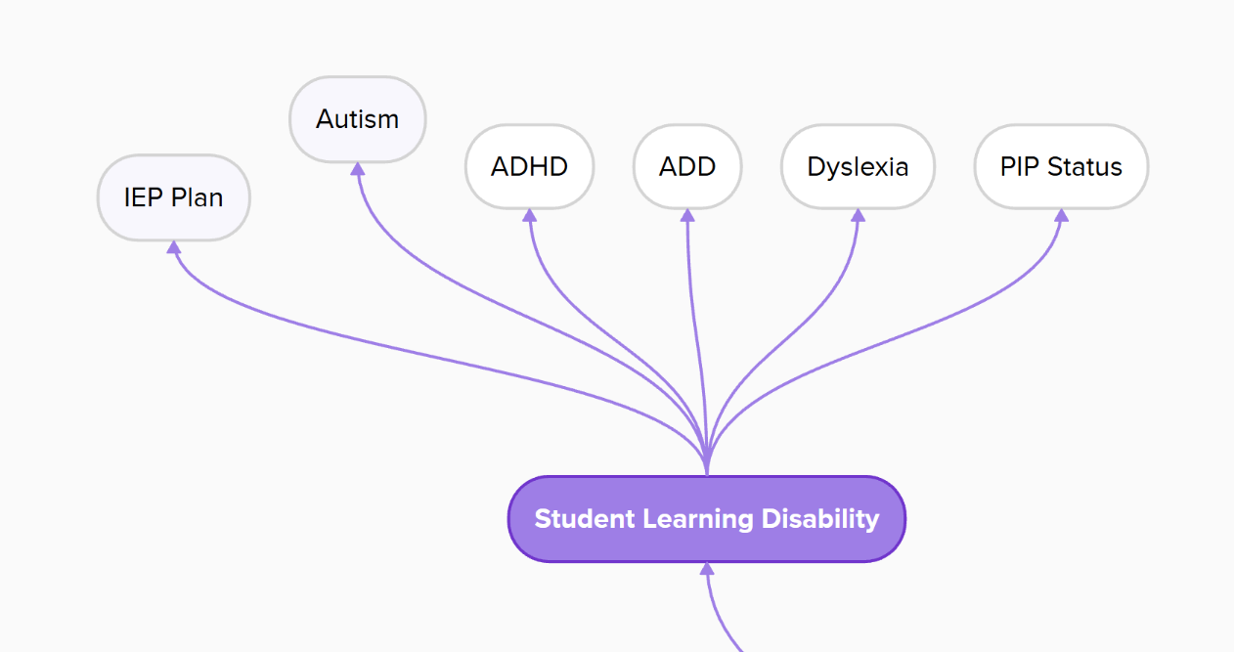
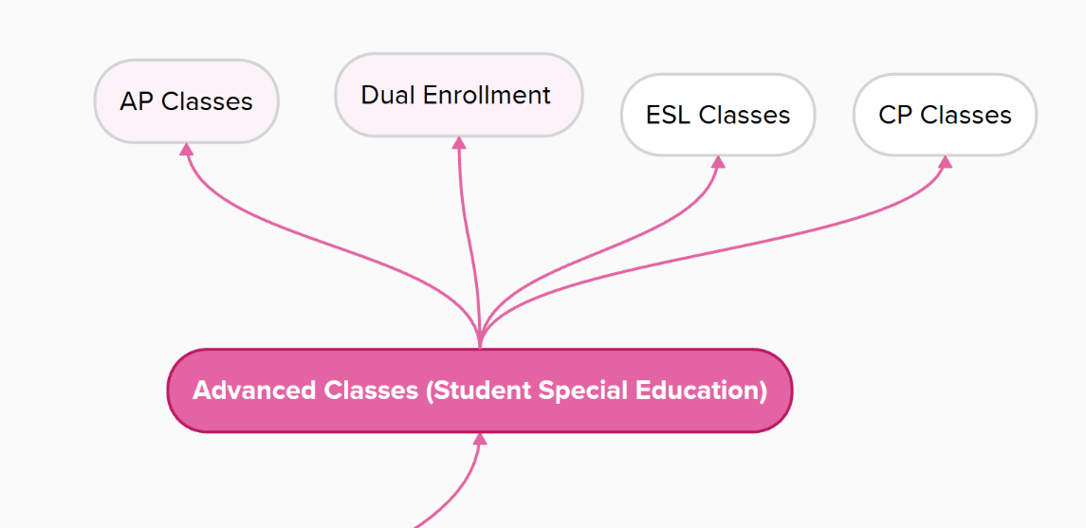
Notes:
Isaiah

Slide 19
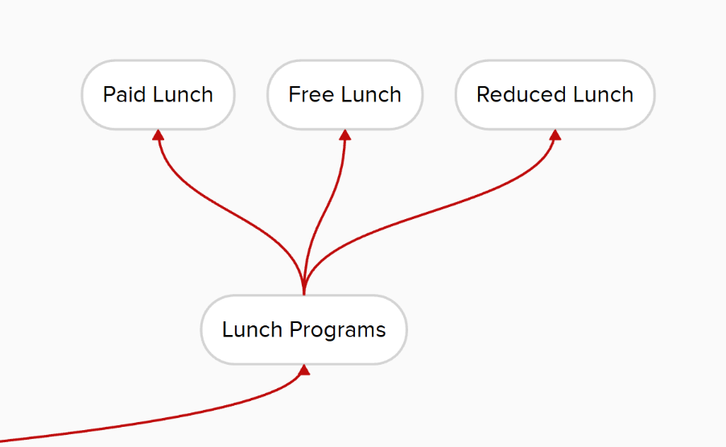
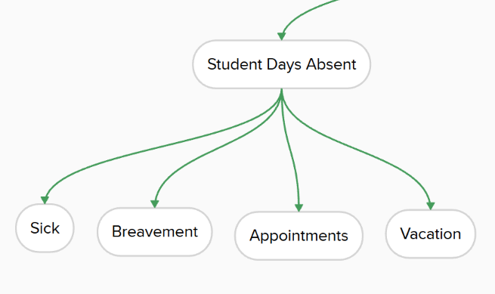
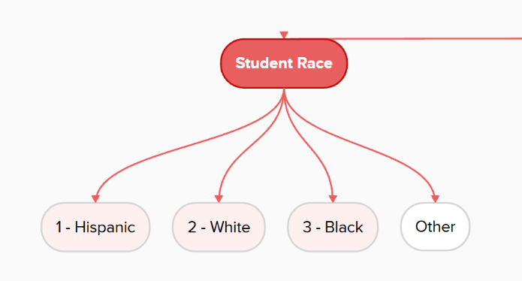
Notes:
Isaiah

Slide 20
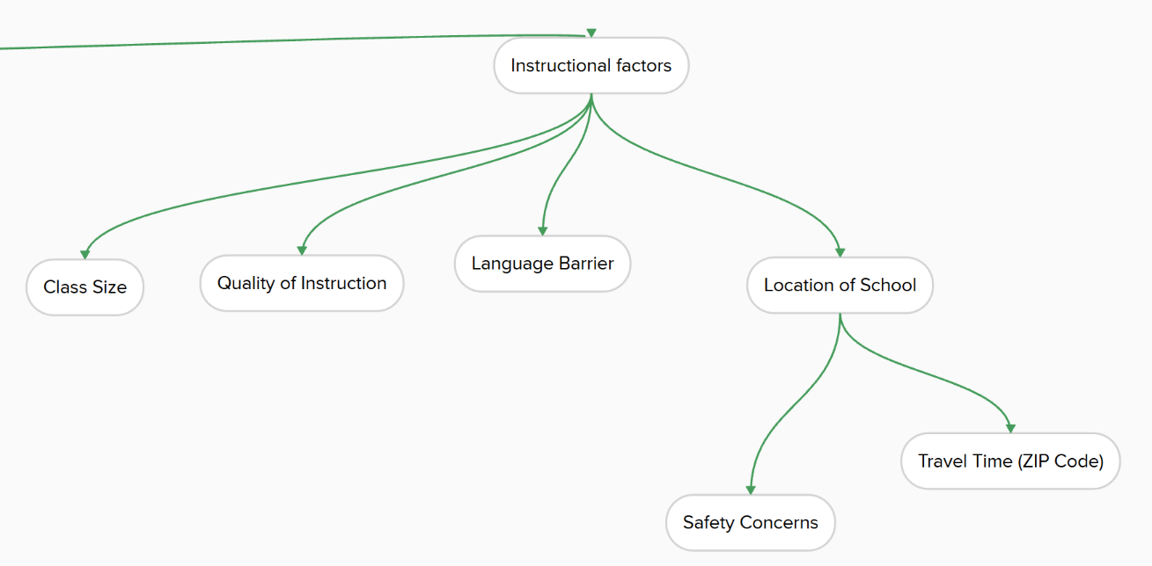
Notes:
Isaiah

Slide 21
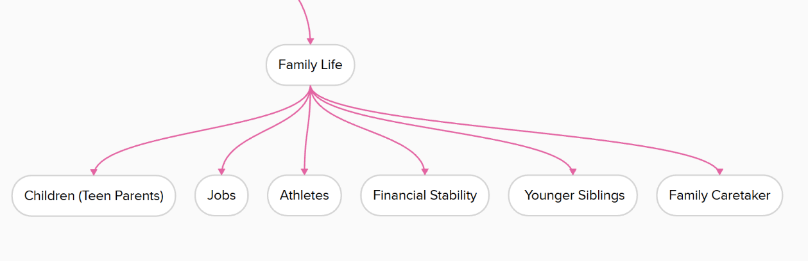
Notes:
Isaiah

Slide 22
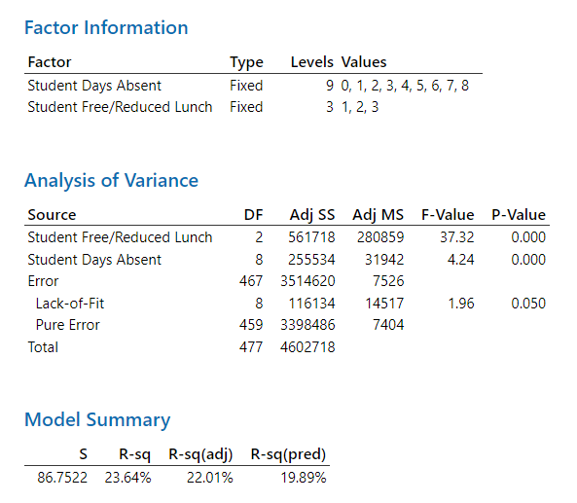
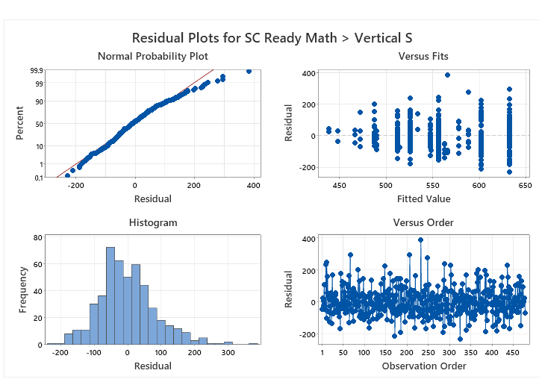
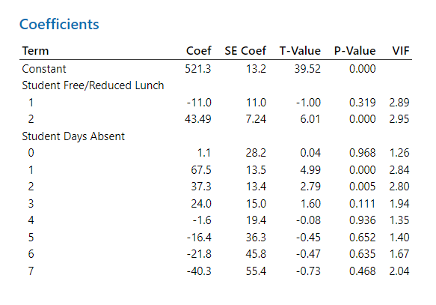
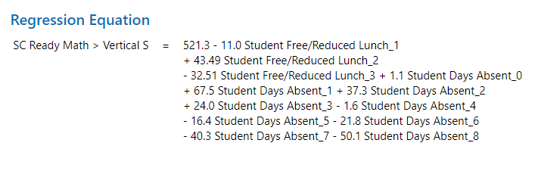
ANOVA General Linear Model
Notes:
Leonard
A p-value (probability value) measures the strength of evidence against the null hypothesis
F-Statistic - determine if the means of different groups are significantly different
Variance Inflation Factor (VIF) is a statistical metric used in regression analysis to measure the severity of multicollinearity—how much the variance of an estimated regression coefficient is increased due to collinearity with other predictors.
Collinearity refers to a situation in regression analysis where independent variables (predictors) are highly correlated with each other
A VIF of 1 indicates no correlation, while values >5–10 indicate high multicollinearity

Slide 23
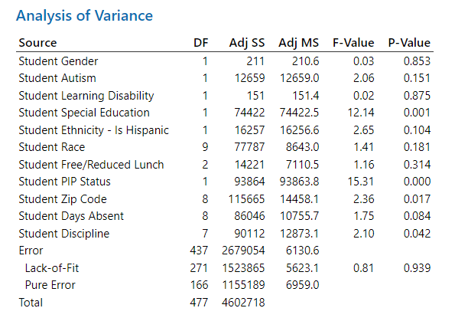
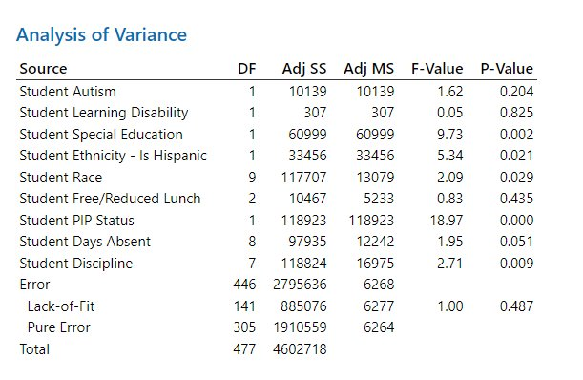










ANOVA General Linear Model
Notes:
Leonard
Gender and Zip Code removed from second chart

Slide 24
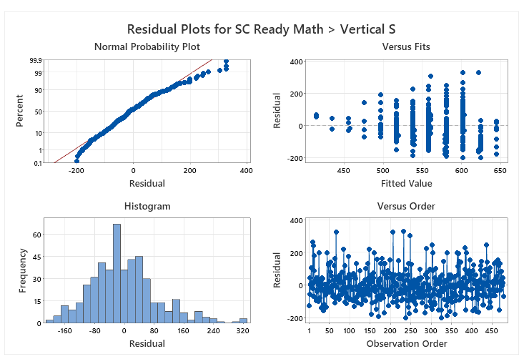
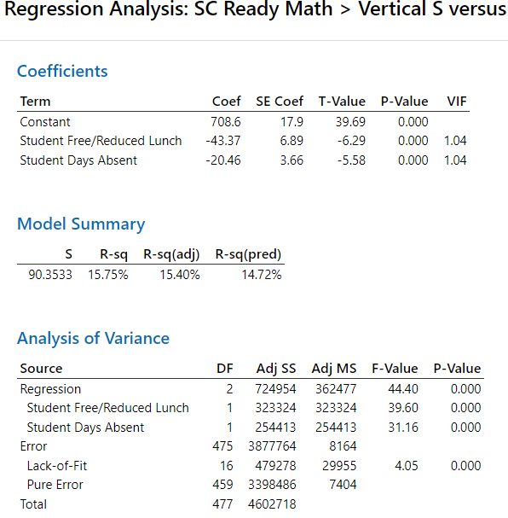
Multiple Regression
Notes:
Leonard

Slide 25
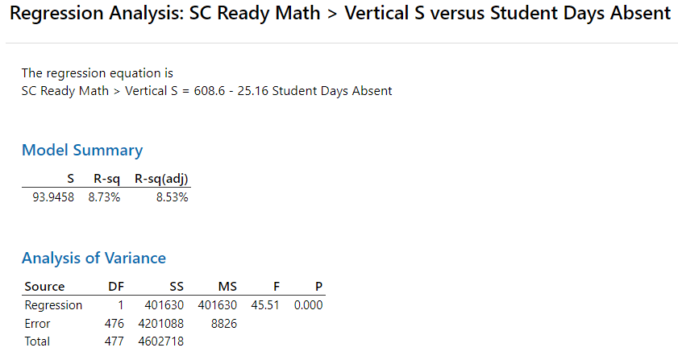
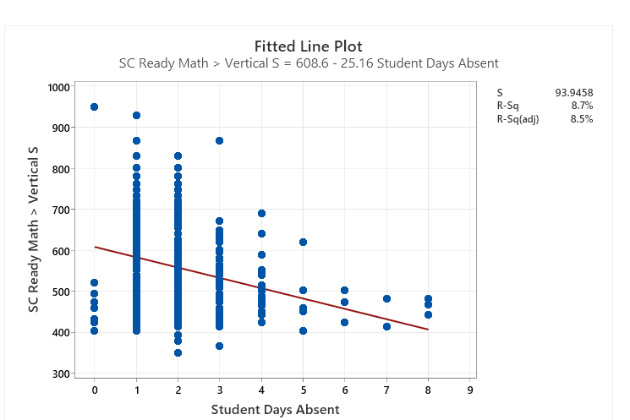
Notes:
Leonard

Slide 26
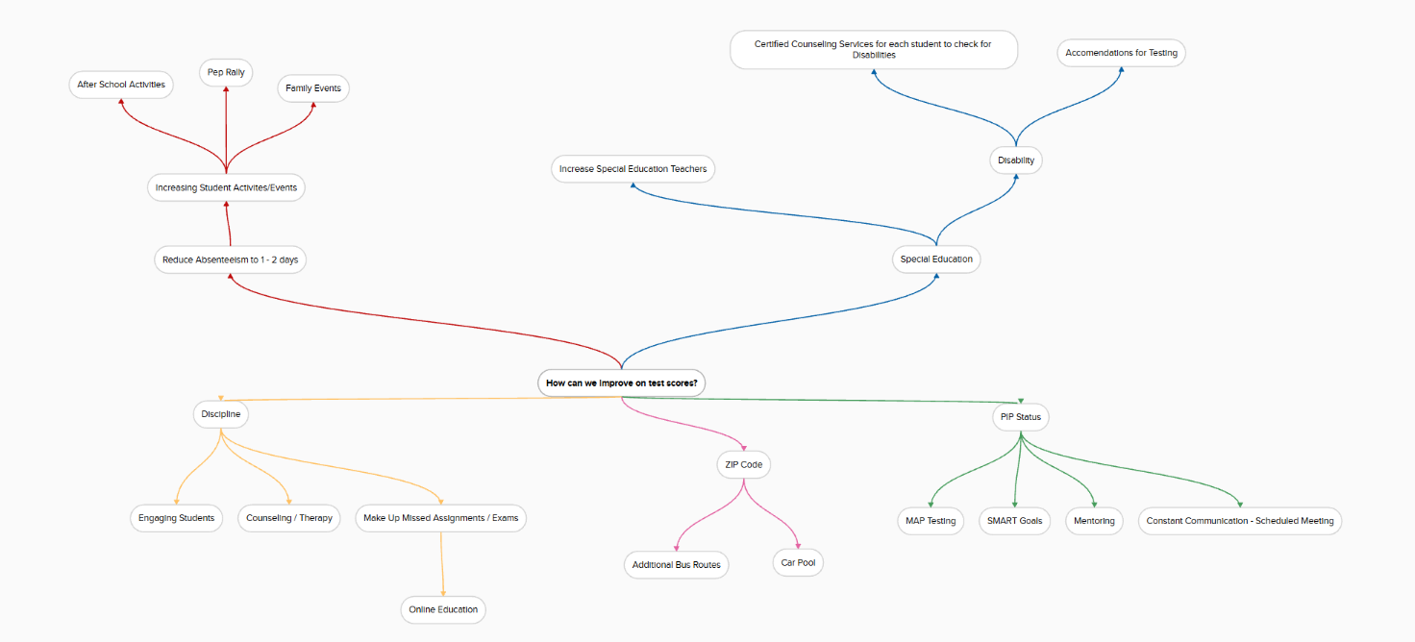
Solutions Brainstorming
Notes:
Isaiah

Slide 27
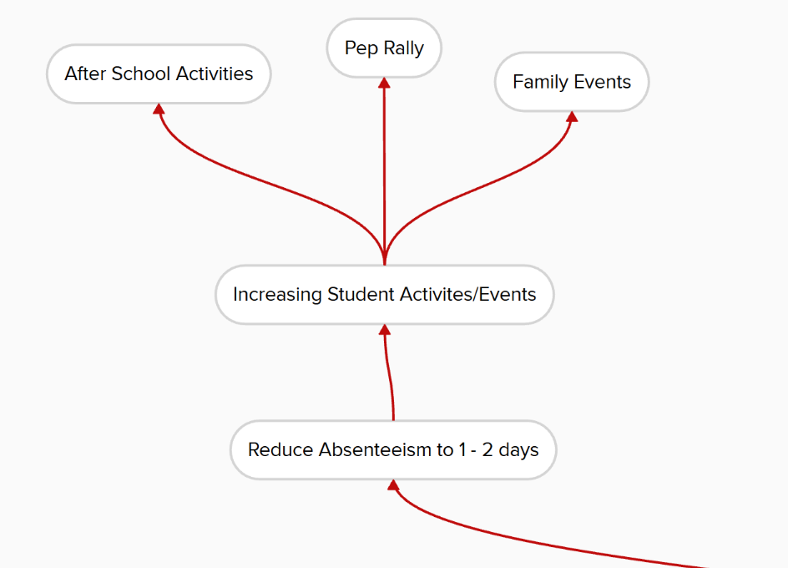
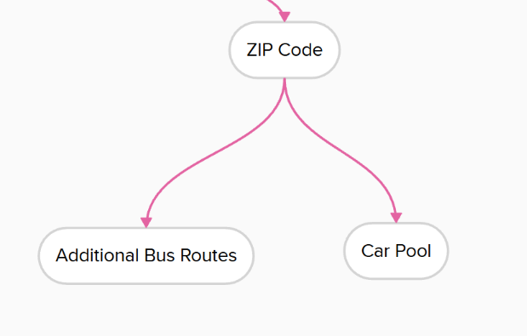
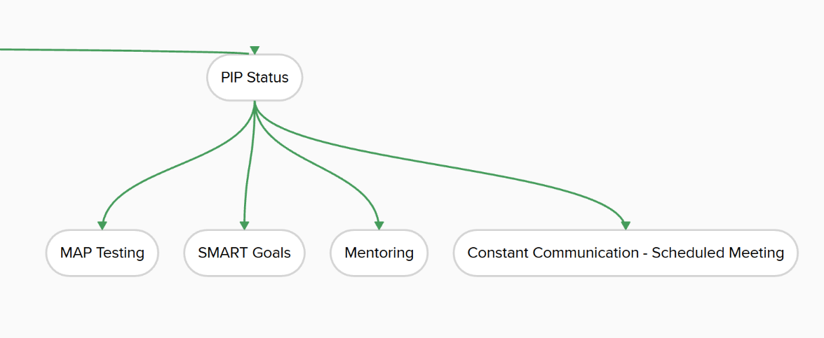
Notes:
Isaiah

Slide 28
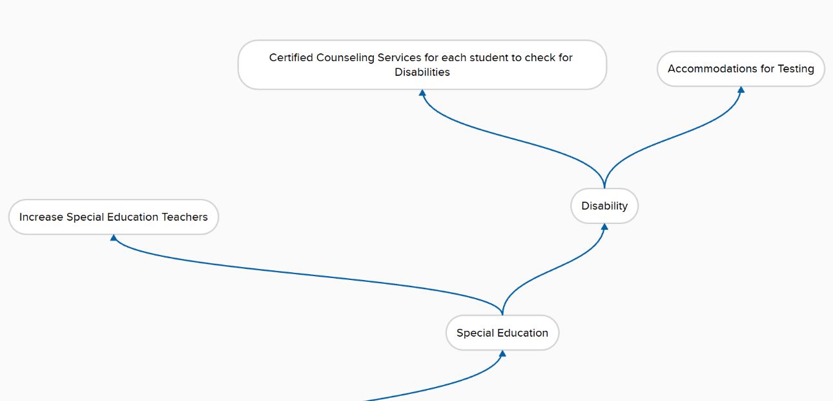
Notes:
Isaiah

Slide 29
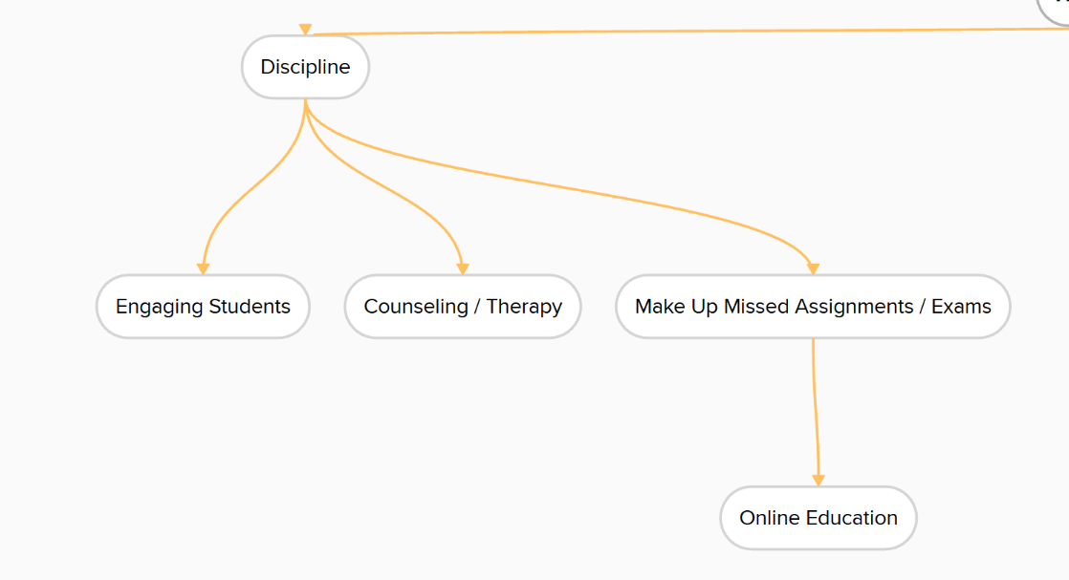
Notes:
Isaiah

Slide 30
Final Recommendations and Justifications
Based on the multiple ANOVA GLM models, we can claim that Student Special Education, Student Ethnicity – is Hispanic, Student Race, Student PIP Status, Student Days Absent, Student Discipline, and Free/Reduced Lunch are all significant. Based on the multiple regression model, we can claim that Student Days Absent and Free/Reduced Lunch are highly significant to Student SC Ready Math > Vertical S Scores.
We recommend that the stakeholders focus on these variables to have the greatest impact to improve on student testing scores. For instance, increasing recreational activities to promote motivation, accommodations for testing and student transportation, improve learning practices, and providing more free/reduced lunches to students.
Notes:
Melisha

